Slide 1
Introduction to Text Analysis

Slide 2
It may seem obvious but.. what is text?
From a sociolinguistic perspective: any symbolically encoded language.
These come in many types:
Alphabetic – symbols (letters) to represent vowels and consonants (e.g., Latin)
Abjads – symbols to represent consonants, with diacritics (or reused consonants) to represent vowels (e.g., Arabic, Hebrew)
Syllabic – Symbol systems representing consonants plus inherent vowels (e.g., Devanagari)
Semanto-phonetic – Symbols that carry meaning and/or sounds (e.g., Chinese)
Plus, there are additional writing systems: Braille, shorthand, phonetic alphabets

Slide 3
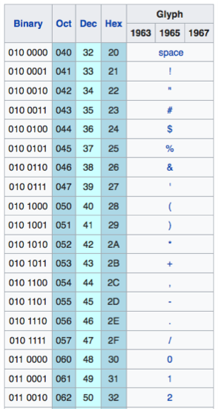
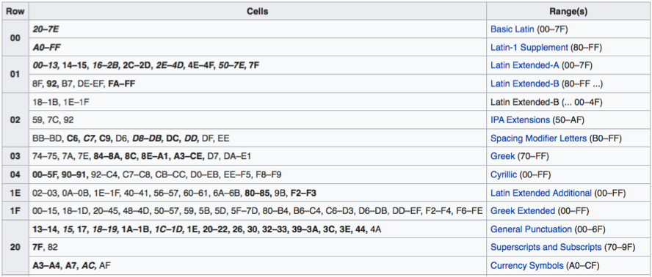
What is Text?
From a computer perspective a binary encoding system for storing written language symbols from the world’s various systems
From ASCII (7-bits) to Unicode: An international standard that supports up to four bytes (32 bits) per symbol and that encodes 137,439 characters from 146 different scripts.

Slide 4
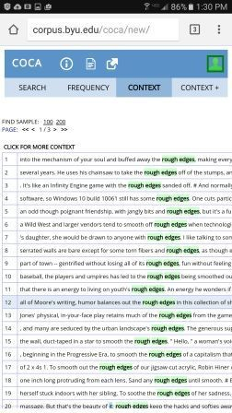
What is text?
From a data scientist’s perspective, a set of documents organized into a corpus, where each document contains an encoded sample of written language, generally:
Human readable files (e.g., plain text)
Metadata describing data source, date of capture, speaker/author, etc.
Character/symbol encoding appropriate to language (Arabic, Hebrew..)
One file per document, or container file includes document separator characters (e.g., newline)
Each file contains unstructured, “natural” language content – generally the same “type” of content for each file in the corpus (i.e., don’t mix tweets with book chapters)

Slide 5
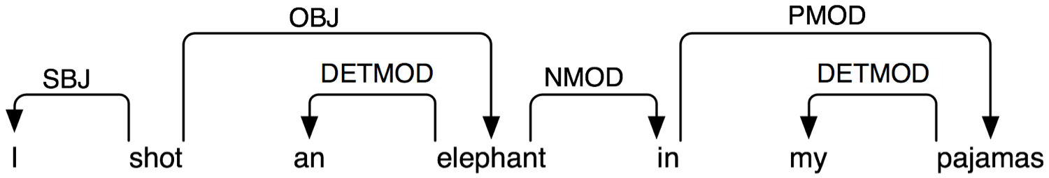
“Unstructured” is the Key
Natural language is notoriously flexible and ambiguous
– even simple tasks like parsing are complicated:
Contractions; Compound words; Misspellings; Proper Names; Preposition Attachment; Vernacular
Transforming a set of documents into data that allow for comparisons, linkages, visualization, or other analysis, is complex and contains many decisions

Slide 6
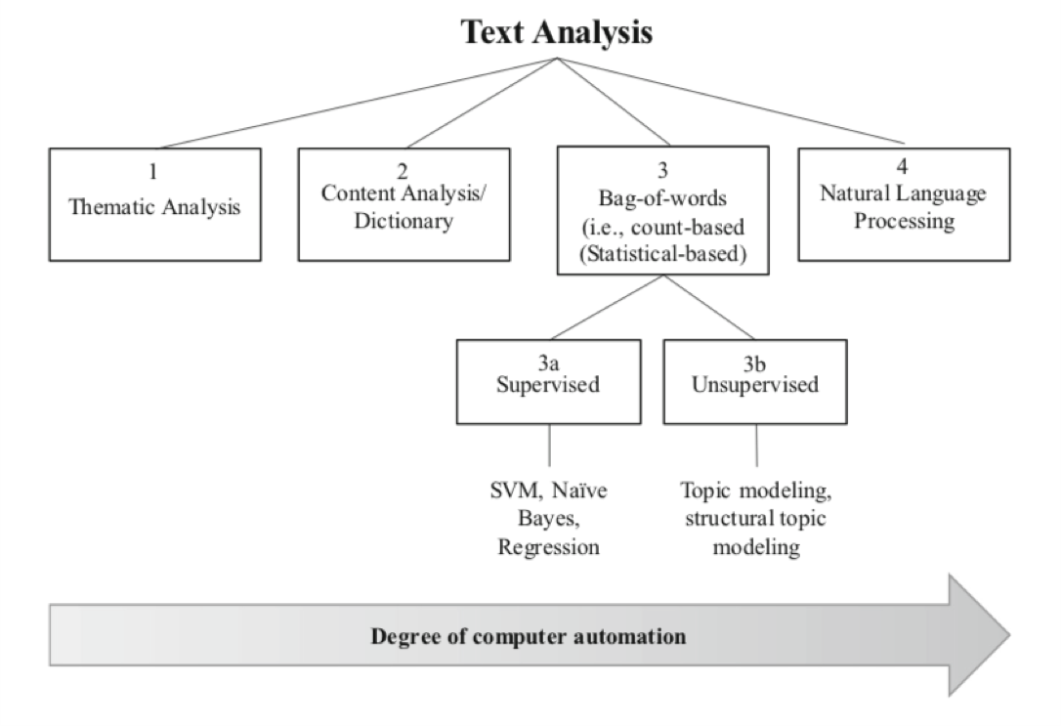
Analytical Overview
Image Credit: Banks et al. (2018), Fig. 1, p. 447

Slide 7
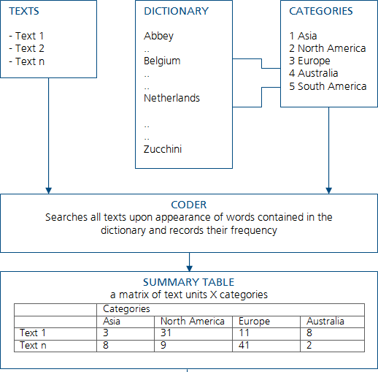
Dictionary-Based Content Analysis
Simplest form of automated text analysis
Reduce texts to frequency counts of various vocabulary words
Lookup vocabulary words in appropriate dictionaries – e.g., positive/negative sentiment
Quantify results based on connection between word frequency and dictionary connotations
Results can be used to compare documents to one another or to summarize corpora

Slide 8
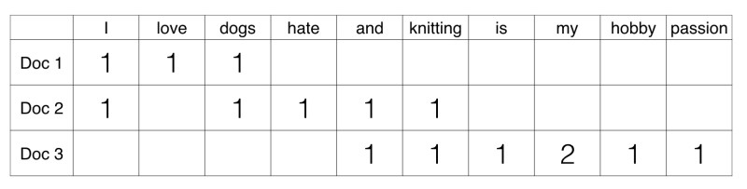
Statistical Approaches
Treat each text fragment as a collection of units/words, without regard to word order
Use many text fragments – e.g. chapters from a book; each fragment is considered a “document”
Compute a term-document matrix (TDM) (or document term matrix); a sparse matrix pinning down the count of appearance of a term (aka word) in a document
Conduct statistical or machine learning analysis on the
TDM to reveal patterns

Slide 9
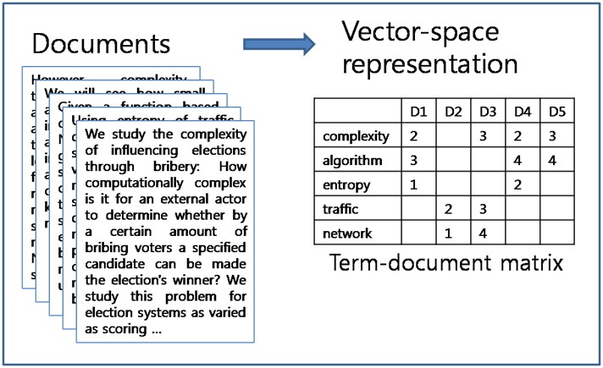
Example TDM

Slide 10
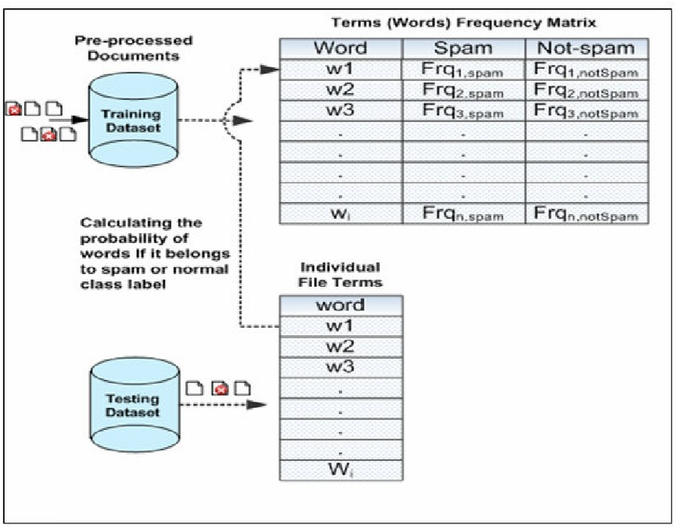
Example Application: Spam Filter

Slide 11
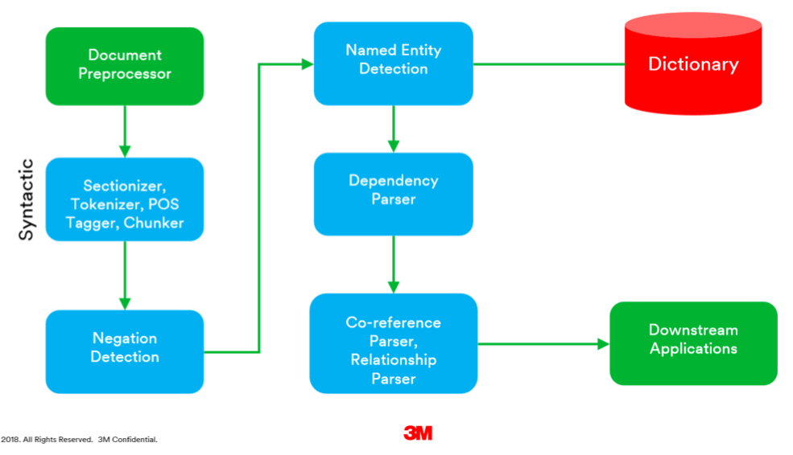
Natural Language Processing
Tokenizes and tags text to detect and preserve part-of-speech
Post processing of tokens tries to resolve syntactic dependencies, co-references, names of entities, sequences of events, etc.
Machine learning can then be used to solve a variety of difficult challenges such question answering, information retrieval, and machine translation, e.g., Alexa, Siri…

Slide 12
Research Questions to Address with Text
Organizations: Examine the dynamics of team formation by analyzing listserv emails
Economics: Analyze the content of job postings to estimate the demand for particular jobs across years/regions
Sociology: Track levels of hate speech over time using text from online forums
Politics: Detect the proportion of fear-based appeals in campaign rhetoric based on party affiliation
Psychology: Conduct sentiment analysis on open ended comments in surveys to detect faking

Slide 13
Text Data Sources
https://github.com/niderhoff/nlp-datasets
Alphabetic list of freely available text corpora
https://www.gutenberg.org
Project Gutenberg, more than 57,000 public domain books available in various formats
https://en.wikipedia.org/wiki/List_of_text_corpora
List of corpora for more than 30 languages including “parallel corpora” where the same text is available in two or more languages
https://gengo.ai/datasets/the-best-25-datasets-fornatural-language-processing/ As the URL suggests. . .

Slide 14
Worked Example 1:
Importing Text and Dictionary Analysis

Slide 15
Overview
Read in a text file, separating into paragraphs, each of which will be treated as a separate “document”
Tokenize the text into a bag of words, representing it as a Document-Term Matrix
Extract term frequency information
Visualize term frequency information
Match term frequency to dictionaries of positive and negative connoted words (merge)
Visualize results
Research question: In a nomination acceptance speech, do positive sentiments predominate over negative ones?

Slide 16
Read in a Speech
library(tm)
charVector <- scan("speech.txt", character(0), sep = "\n") head(charVector)
"I speak tonight of gratitude, achievement, and high hopes for our country."
"Tonight, I think first of those who helped get me here
- starting with the people of Tennessee. Then, those who braved the first snows of Iowa and New Hampshire -- and all of you here, from all over this country, who have come with me into the warm sunlight of this great city."
"While I can't thank each of you individually in words,
I do so in my heart."
"And I know you won't mind if I single out someone who
has just spoken so eloquently, someone I've loved with my whole heart since the night of my high school senior prom -- my wife, Tipper. We've been lucky enough to find each other all over again at each new stage of our lives - and we just celebrated our 30th wedding anniversary."

Slide 17
Read in Dictionaries
posWords <- scan("positive-words.txt", character(0), sep = "\n") #
2006 items
negWords <- scan("negative-words.txt", character(0), sep = "\n") #
4783 items
head(posWords,15)
head(negWords,15)
> head(posWords,15)
[1] "a+" "abound" "abounds" [4] "abundance" "abundant" "accessable"
[7] "accessible" "acclaim" "acclaimed"
[10] "acclamation" "accolade" "accolades" [13] "accommodative" "accomodative" "accomplish"
> head(negWords,15)
[1] "2-faced" "2-faces" "abnormal" "abolish"
[5] "abominable" "abominably" "abominate" "abomination"
[9] "abort" "aborted" "aborts" "abrade" [13] "abrasive" "abrupt" "abruptly"

Slide 18
Bag of words: Two class transformations
wordVector <- VectorSource(charVector)
wordCorpus <- Corpus(wordVector)
class(wordVector); typeof(wordVector); length(wordVector) class(wordCorpus); typeof(wordCorpus); length(wordCorpus)
> class(wordVector); typeof(wordVector); length(wordVector) [1] "VectorSource" "SimpleSource" "Source" [1] "list" [1] 166 > class(wordCorpus); typeof(wordCorpus); length(wordCorpus) [1] "SimpleCorpus" "Corpus" [1] "list" [1] 166

Slide 19
Token Clean Up
# first step transformation: make all of the letters in "wordCorpus" lowercase wordCorpus <- tm_map(wordCorpus, content_transformer(tolower))
# second step transformation:
#remove the punctuation in "wordCorpus" wordCorpus <- tm_map(wordCorpus, removePunctuation
# third step transformation: remove numbers in "wordCorpus" wordCorpus <- tm_map(wordCorpus, removeNumbers)
# final step transformation: take out the "stop" words, such as "the", "a" and "at" wordCorpus <- tm_map(wordCorpus, removeWords, stopwords("english")) wordCorpus[["1"]][["content"]] # Review what’s left of the first paragraph
Ignore warnings
about dropped
documents.
> wordCorpus[["1"]][["content"]] [1] " speak tonight gratitude achievement high hopes country"

Slide 20
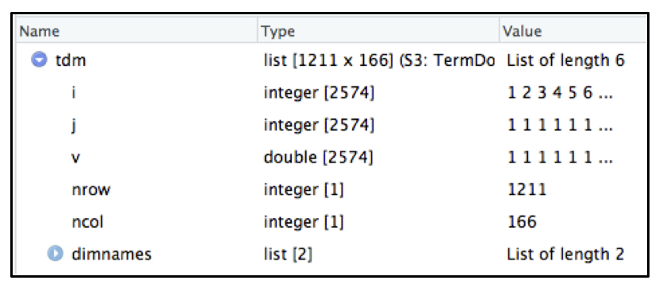
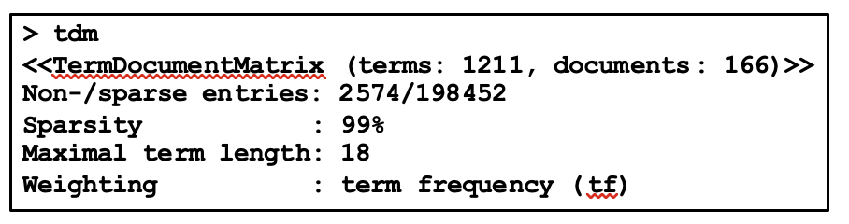
Create a term-document matrix "tdm"
tdm <- TermDocumentMatrix(wordCorpus)
tdm
View(tdm)

Slide 21
Some things to do with a TDM
fTerms <- findFreqTerms(tdm, lowfreq = 20)
# Common terms: "tonight" "new" "people”
# "children" "family" "will" "families" "america" findAssocs(tdm, fTerms, 0.4)
Note: Excerpted results.
> findAssocs(tdm, fTerms, 0.4)
$people fighting champion charged constitution district
0.62 0.53 0.53 0.53 0.53 $children raising
0.4
$families tax working
0.41 0.40

Slide 22
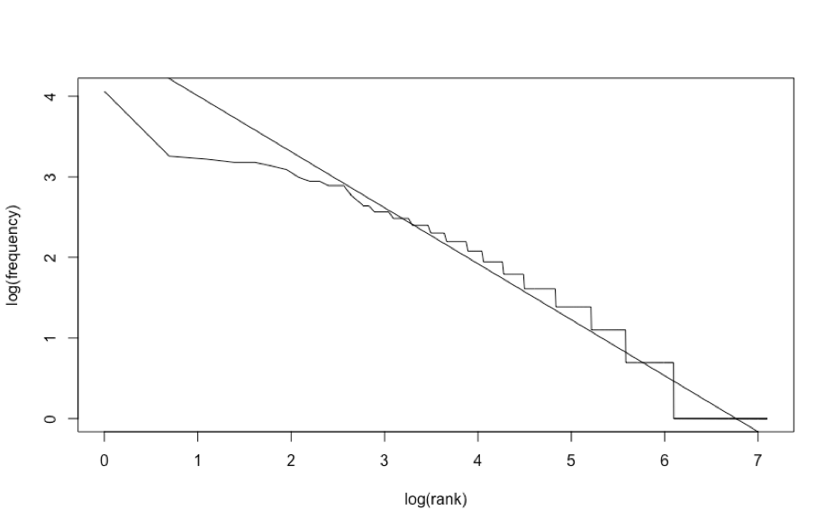
Zipf’s Law: Zipf_plot(tdm)
The numeric frequency of any word in an NL corpus is negatively related to its frequency rank.
Example: Most frequent word occurs 2X as much as the next most frequent word, 3X as much as the third most frequent word, etc. . .
Bumpy line shows actual
Straight line shows ideal
High rank words are less frequent than expected

Slide 23
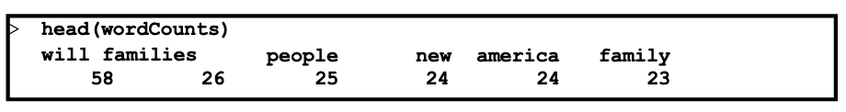
Aggregate TDM into vector of word counts
m <- as.matrix(tdm) # Coerce to regular matrix
# create a list of counts for each word named "wordCounts" wordCounts <- rowSums(m)
# sort words in "wordCounts" by frequency wordCounts <- sort(wordCounts, decreasing=TRUE)
# check the first several items in "wordCounts" to see if it is built correctly head(wordCounts)
totalWords <- sum(wordCounts) # Calculate the total number of occurrences

Slide 24
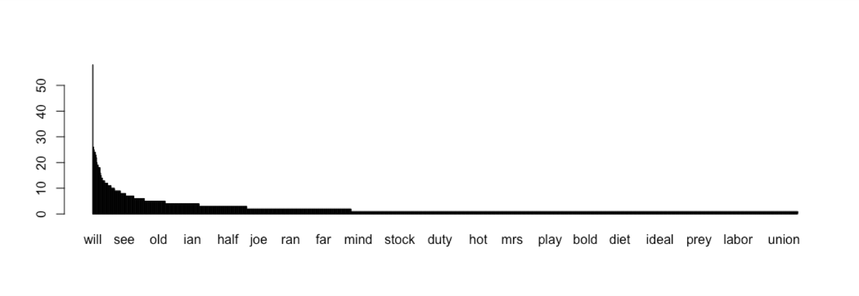
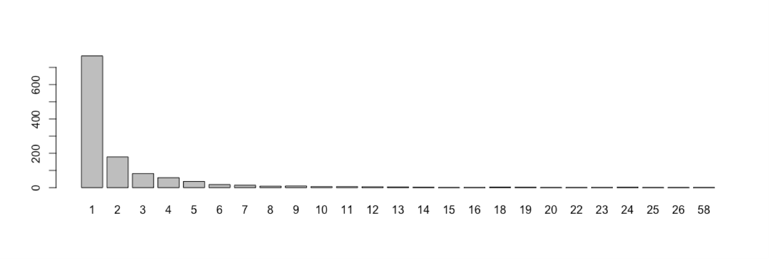
Word Count Bar Plots
Note: only a small
barplot(wordCounts) sub
Raw frequencies, term by term, for 1211 terms
subset of the term
labels are shown
due to space
barplot(table(wordCounts))
Tabulation of frequency values (i.e., how many terms occurred at the frequency shown on the x-axis)

Slide 25
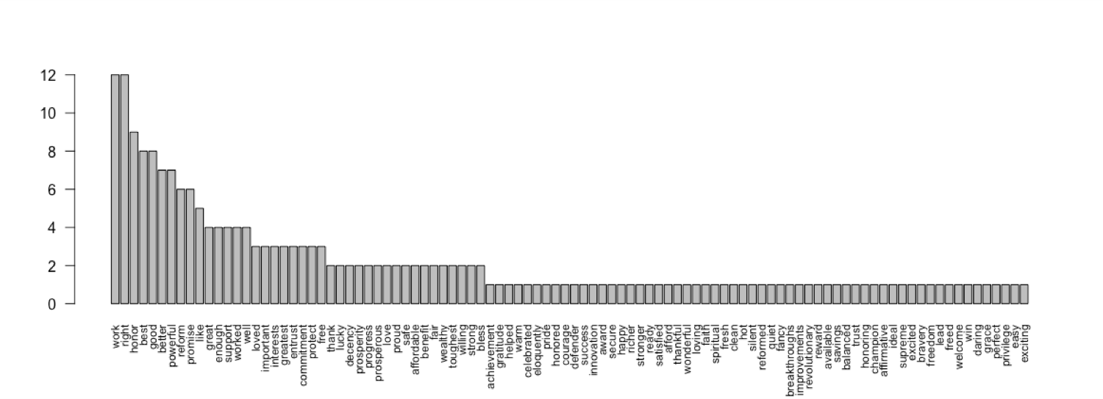
Positive Word Matches: 7.8% of total
matchedP <- match(names(wordCounts), posWords, nomatch = 0) matchedP <- matchedP != 0 # Make a Boolean map
matchedP <- wordCounts[matchedP] # Apply Boolean map
barplot(matchedP,las=2,cex.names=0.75) # Small vertical labels sum(matchedP)/totalWords # Proportion of pos words vs total
barplot(matchedP, las=2, cex.names=0.75)
Raw frequencies of occurrence of terms that exist in the positive words dictionary

Slide 26
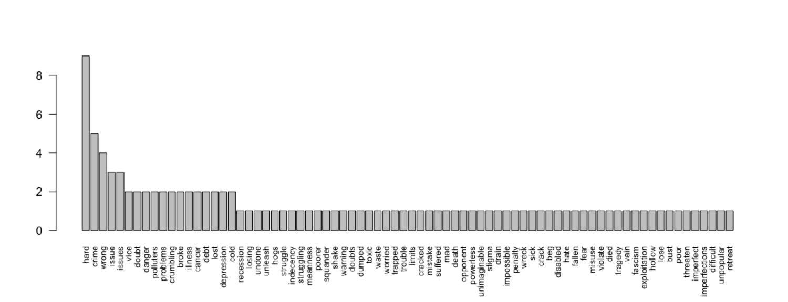
Exercise 14.1: Generate the Negative Word Matches and Interpret Results
barplot(matchedN, las=2, cex.names=0.75) Raw frequencies of occurrence of terms that exist in the negative words dictionary

Slide 27
Answering a Research Question
Dictionary analysis indicated that positive terms occurred twice as frequently as negative terms in this speech
This result affirms that idea that a nomination acceptance speech is typically an affirmative celebration of success in the primary
Other recent nomination speeches should be similarly analyzed to see if the pattern holds

Slide 28
Exercise: Analyze another speech
Analyze another presidential acceptance speech using the same code
Go to:
https://www.presidency.ucsb.edu/documents/appcategories/elections-and-transitions/conventionspeeches
to obtain another speech
Copy and paste the nominee’s remarks from the web page into a plain text file on your computer
Check to make sure that there are line breaks for each paragraph
Use the same positive and negative word dictionaries

Slide 29
Brief Review of POS Tagging

Slide 30
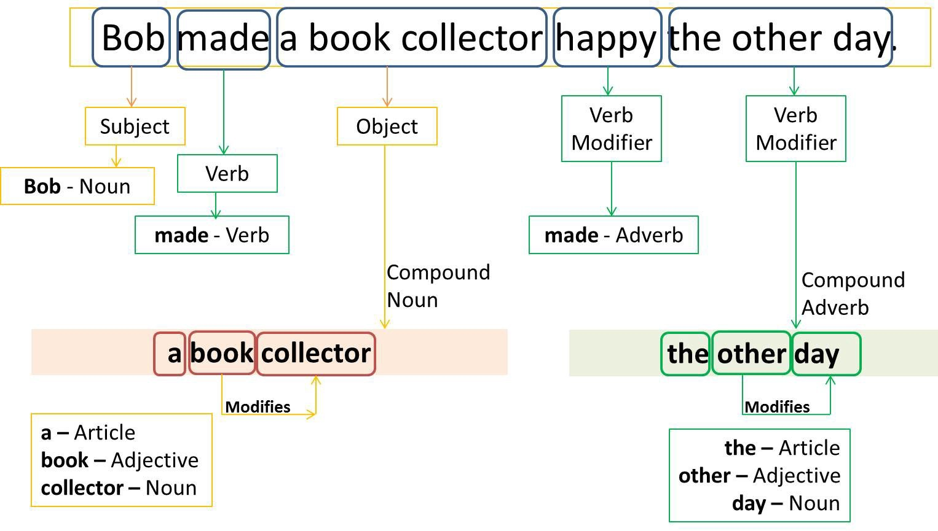
Part of Speech Tagging
NLP parsers contain extensive, language-specific logic for decomposing sentences (tokenizing) into parts of speech
Prepositions – in, on, at, with
Conjuctions – but, or, and, for

Slide 31
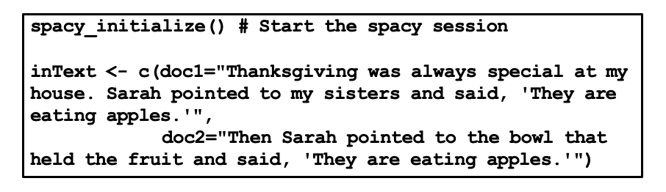
Example using spacyr
spacyr is an R package “wrapper” around an open source Python package called spaCy
v2.0 of spaCy is one of the most accurate and fastest parsers available

Slide 32
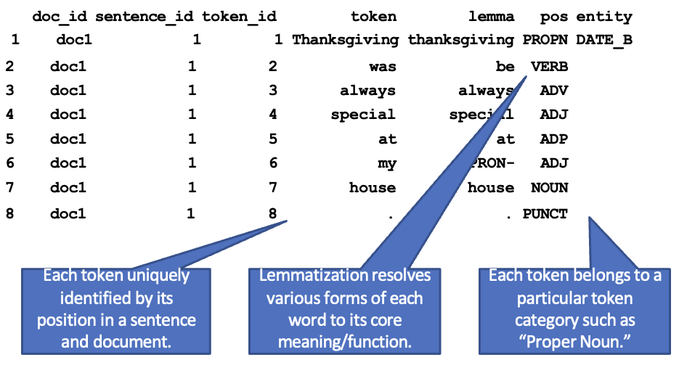
Tokenized Output

Slide 33
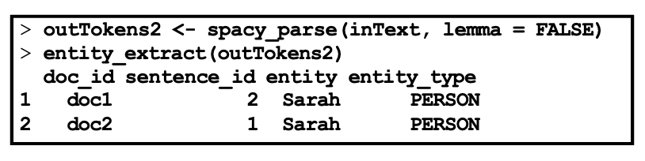
Entity Detection
Parsers usually contain dictionaries and rules that support detection of named entities such as people, places, and organizations

Slide 34
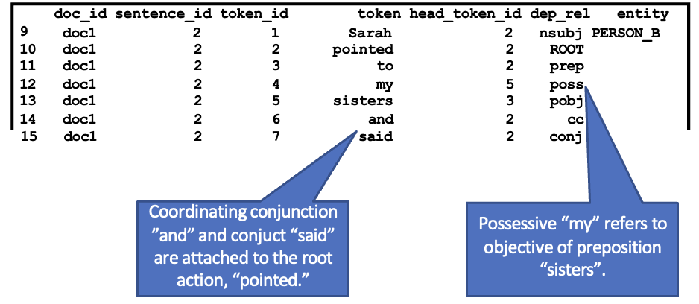
Dependency Tagging
Syntactical dependencies show, for example, which noun an adjective modifies

Slide 35
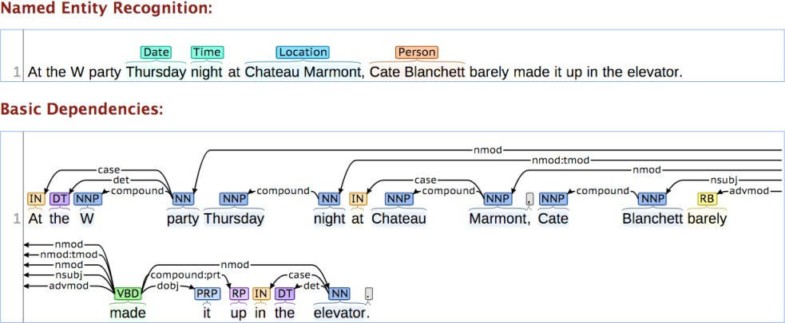
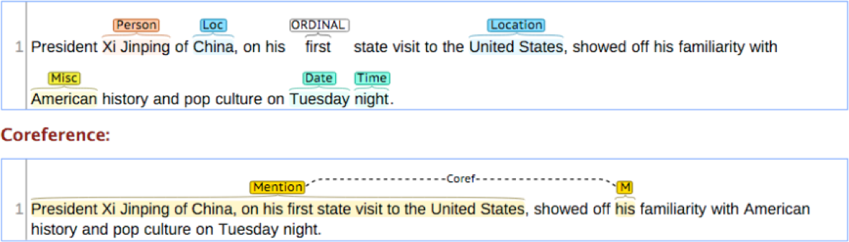
Harder Problem: Detecting Co-Reference

Slide 36
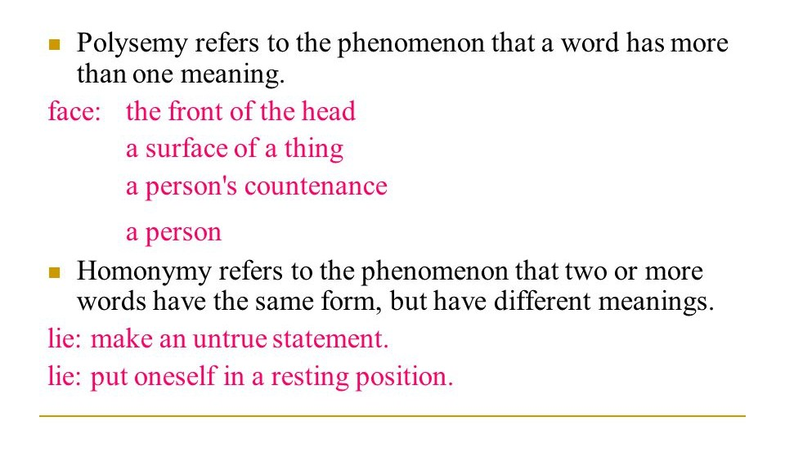
Major Challenges in NLP: Polysemy and Homonymy
”lots of new faces around here!”

Slide 37
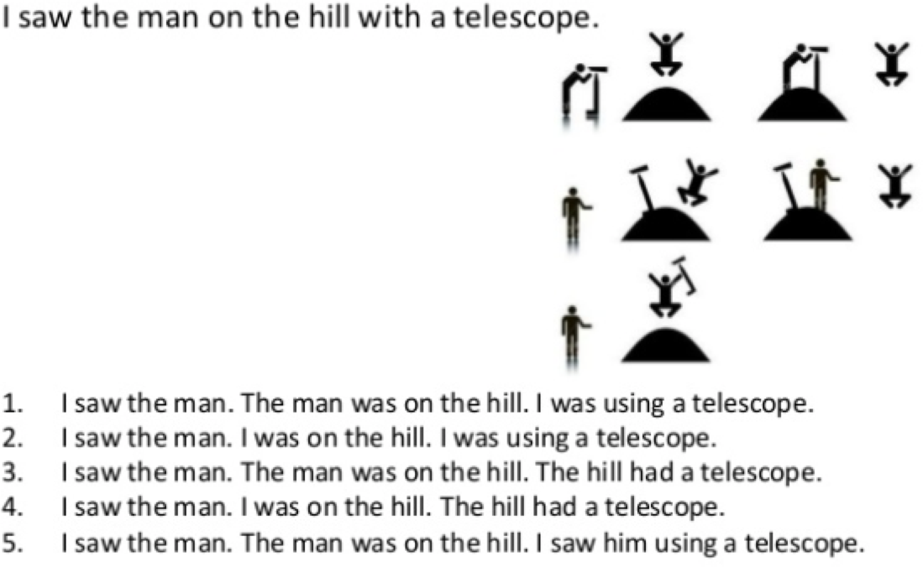
Major Challenges in NLP: Preposition Attachment

Slide 38
Elliptical Construction
Elliptical construction occurs when words are left out because they are generally understood to be there. Several types:
Type | Example
Verb Gapping | Jeff can play the bass, and Larry . . . the guitar.
Verb Phrase | Jeff wanted to buy the instrument and did . . .
Nominal | Larry played one song, then Jeff played two . . .
 | . . . and many more!
Parsers have difficulty inferring the missing phrases, making later steps (like dependency or co-reference) more difficult/less accurate.

Slide 39
Philosophical Pitfalls:
Semantics Versus Pragmatics
Authentic human communication works in an interpersonal context of shared meanings, personal histories, and prevailing circumstances
In this perspective, many texts, on their own, do not contain sufficient information to truly convey the underlying meaning of the utterances
Non-propositional speech acts (when captured in text) lose meaning when separated from their related performances. Example: “I’ll finish the job now.”
Give an example of an utterance whose meaning varies depending on context. . .

Slide 40
Worked Example #2: Topic Modeling of Text

Slide 41
Topic Modeling
Considered an unsupervised data/text mining technique: Does a “bottom-up” analysis of documents, topics, and words with no “criterion” (ground truth) to train against
Extracts topics that are characterized by a combination of more frequent words
Each document in a corpus comprises a mixture of topics

Slide 42
Example Using National Anthems
> anthems <- read.csv(‘anthems.csv')
> charVector <- anthems$Anthem
> head(charVector, 1)
[1] "Around our flag we stand united, With one wish and one goal, A sacred oath we bestow upon it Proclaiming loyalty for our salvation. From war abstains only he, Who a traitor is born, He who is a true man is not frightened, But dies a warrior to the cause. With weapons in our hands a-brandished, We will defend our fatherland, Our sacred rights weÃƒÂ¢Ã¢â€šÂ¬Ã¢â€žÂ¢ll not relinquish …

Slide 43
library("quanteda")
The quanteda package was developed by Kenneth Benoit (http://kenbenoit.net) at the London School of Economics
A comprehensive text processing package that uses some C++ and Fortran – but unlike Stanford Core NLP tools no Java; mostly runs faster and with less memory than Stanford Core NLP
Includes readtext(), a wrapper for a wide range of text files (PDF, CSV, text, XML, JSON) that simplifies reading in folders of text files
Directly supports document-level variables for machine learning

Slide 44
Preparing and Visualizing Corpus
anthemcorpus <- corpus(charVector, docnames=anthems$country)
paras <- corpus_reshape(anthemcorpus, to="paragraphs")
anthem_dtm <- dfm(paras, stem=TRUE, remove_punct=TRUE, remove_symbols = TRUE, remove_numbers = TRUE, remove=c(stopwords("english")))
anthem_dtm <- dfm_remove(anthem_dtm, c("s","ã","â",'thi'))
anthem_dtm <- dfm_trim(anthem_dtm, min_termfreq=20)
anthem_dtm
colnames(anthem_dtm)
library("quanteda.textplots")
textplot_wordcloud(anthem_dtm) # visualize words

Slide 45

>textplot_wordcloud(anthem_dtm)

Slide 46
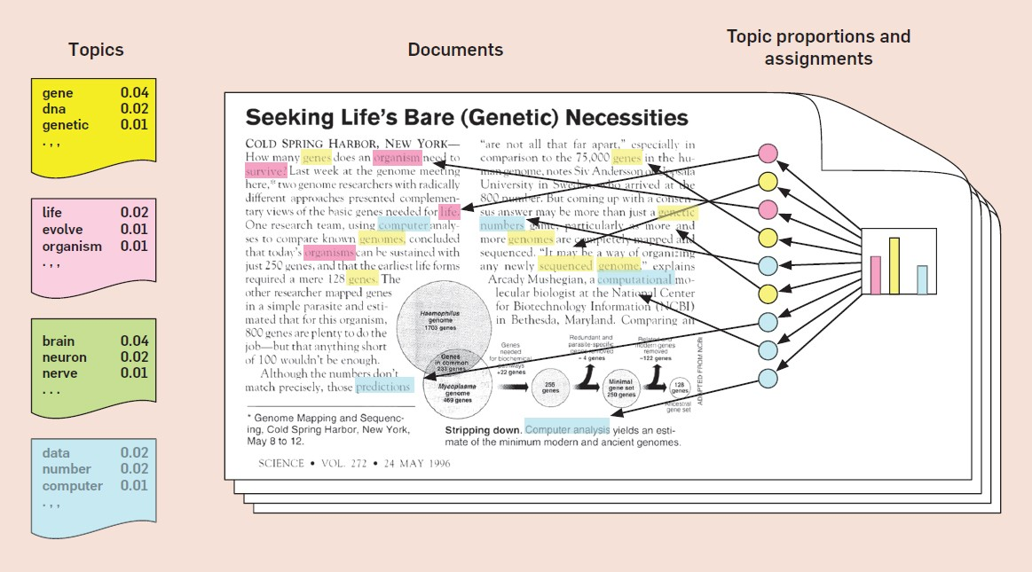
Using Latent Dirichlet Allocation to Infer Topics from Words and Documents

Slide 47
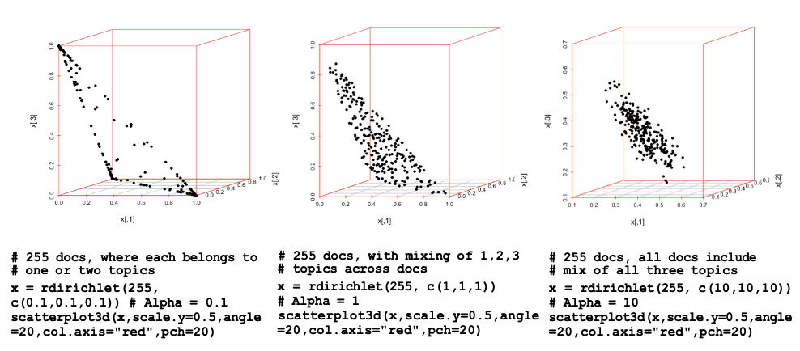
Dirichlet Distributions at Different Alpha Levels
LDA is a Bayesian technique, guided by two hyperparameters of the Dirichlet distribution, alpha and beta. Low “prior” alpha value has each document composed of only a few key topics. (good separation) Low “prior” beta has each topic composed of only a few key words. (more dense)

Slide 48
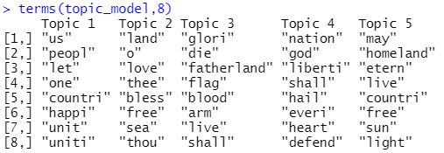
Estimate LDA Model
# topic model with 5 total topics (more on how to choose the number of topics)
topic_model <- LDA(anthem_topics, method = "VEM", k=5) # Latent Dirichlet Allocation
termsOut<- terms(topic_model, 8) # Descriptive stems for each topic

Slide 49
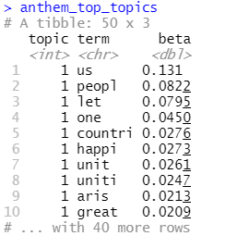
Examine beta: The per-topic-per-word probability
library(tidytext) # All three packages: “tidyverse” library(ggplot2) # by Hadley Wickham library(tidyverse)
# A custom “tidier” for LDA output!
tidyTopics <- tidy(topic_model, matrix="beta")
# The %>% is “pipe” notation
anthem_top_topics <- tidyTopics %>%
group_by(topic) %>%
top_n(10, beta) %>%
ungroup() %>%
arrange(topic, -beta)

Slide 50
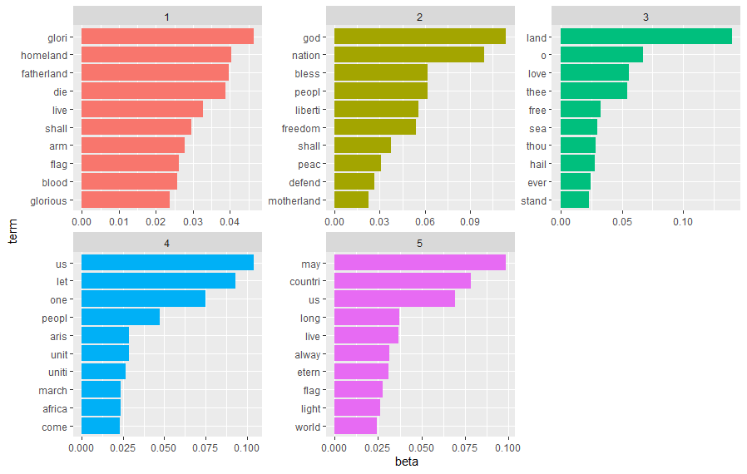
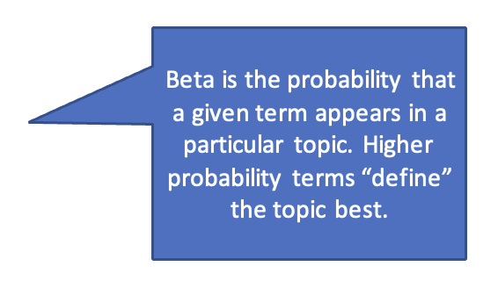
Use ggplot to visualize topics and terms
Note: your results will vary, but should reach to similar conclusions.
anthem_top_topics %>%
mutate(term = reorder(term, beta)) %>% ggplot(aes(term, beta, fill = factor(topic))) + geom_col(show.legend = FALSE) +
facet_wrap (~ topic, scales = “free”) +
coord_flip()

Slide 51
Try to name topics?
Topic 1 top keywords: glory, homeland, fatherland
My title for topic 1:
Glory to homeland

Slide 52
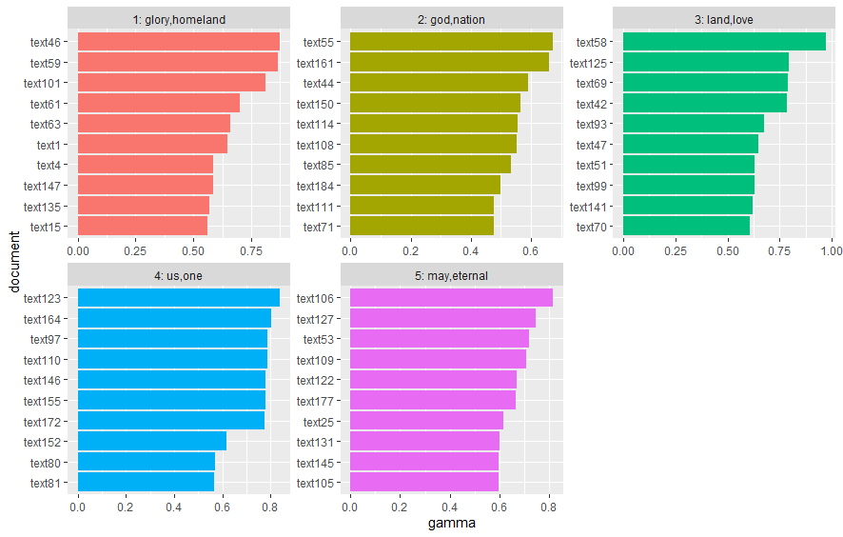
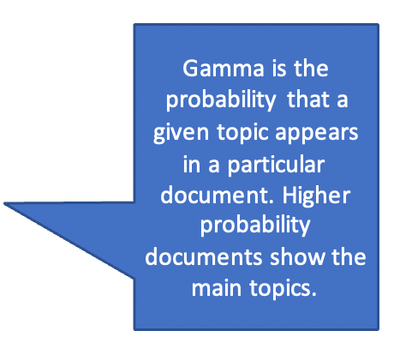
Use ggplot to visualize documents and topics
anthem_top_topics %>%
mutate(document = reorder(document, gamma)) %>% ggplot(aes(document, gamma, fill = factor(topic))) + geom_col(show.legend = FALSE) +
facet_wrap (~ topic, scales = “free”) +
coord_flip()

Slide 53
Try to name topics?
Topic 1 appears strongly in 3 anthems:
What countries are they?: Bolivia, Mexico, Iraq
Of the homeland, the lofty name. In glorious splendour may we keep [it] And in its honour let's swear once again: To die before living as slaves!

Slide 54
Try to name topics?
Topic 3?: Land of love
Sri Lanka:
Plenteous in prosperity, Thou, Beauteous in grace and love, Laden with grain and luscious fruit, And fragrant flowers of radiant hue, Giver of life and all good things, Our land of joy and victory, Receive our grateful praise sublime, we worship, worship Thee.

Slide 55
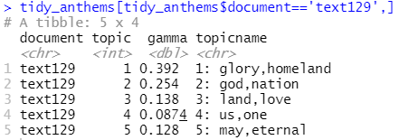
Use ggplot to visualize documents and topics
Note: For a given country, probabilities add up to 1:

Slide 56
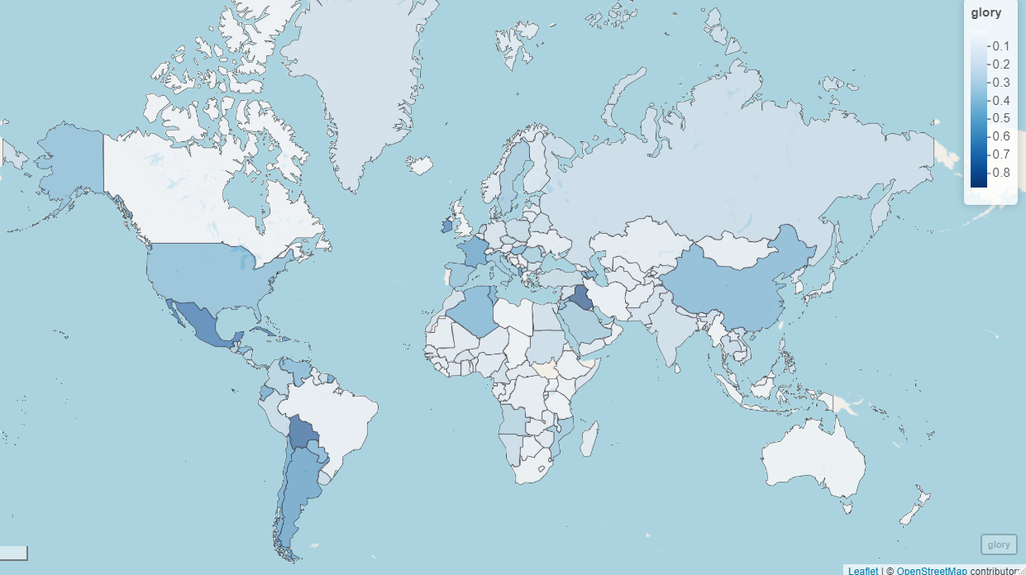
Try mapview()!!
library(mapview)
mapview(out,zcol='gamma', col.regions = blues9,
label=paste(out$CountryCode ,out$gamma),layer.name ='glory')

Slide 57
Well.. with some cleaning
tidy_anthems <- tidy_anthems %>% mutate(countryid=as.numeric(str_extract(tidy_anthems$document, "[0-9]+"))) # need the codes
anthems <- anthems %>%
mutate(countryid = factor(rownames(anthems)))
df <- merge(tidy_anthems,anthems,on='countryid’)
#######################################
#install.packages("rnaturalearth")
#install.packages("rnaturalearthdata")
library("rnaturalearth")
library("rnaturalearthdata")
world <- ne_countries(scale = "medium", returnclass = "sf")
world$CountryCode = world$su_a3
df$CountryCode = df$Alpha.3
out <- merge(df, world, on = 'CountryCode')
out <- out %>% filter(topic==1) %>% mutate(gamma=round(gamma,2))
# convert to spatial object
out <- st_as_sf(out)
library(mapview)
mapview(out,zcol='gamma', col.regions = blues9, label=paste(out$CountryCode ,out$gamma),layer.name ='glory')

Slide 58
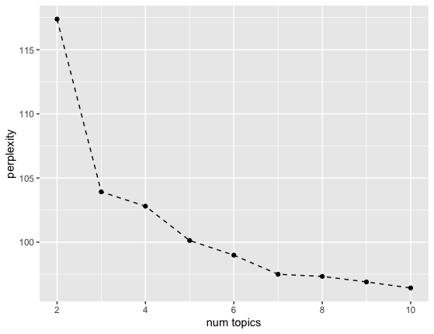
Use Perplexity to Determine Number of Topics
library("topicmodels")
interview_topics <- convert(anthem_dtm, to = "topicmodels")
maxTopics <- 10 # Max number of topics we will allow to form
set.seed(1)
perList <- NULL # We are going to make a list of perplexity values
# Loop: Try every number of topics from 2 up to maxTopics
for (i in 2:maxTopics) {
topic_model <- LDA(anthem_topics, method = "VEM", k=i) # Latent Dirichlet Allocation
perList[i-1] <- perplexity(topic_model)
}
names(perList) <- as.character(2:maxTopics)
perList_df <- as.data.frame(perList)
library(ggplot2)
ggplot(data=perList_df,aes(x=as.numeric(rownames(perList_df)), y=perList)) + geom_point() + geom_line(linetype='dashed') + labs(x='num topics',y='perplexity')
This is an elbow plot!
Exercise: re-do the analysis with optimal k

Slide 59
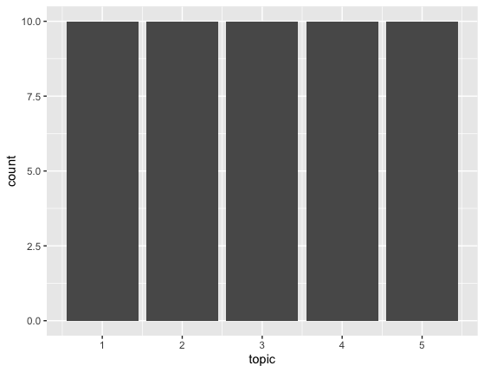
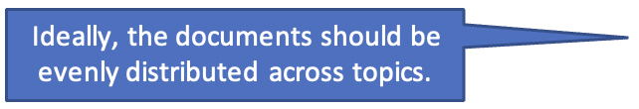
How Many Documents for Each Topic?
> top_anthems %>% group_by(topic) %>% summarize(count=n(),av_gamma = mean(gamma))
# A tibble: 5 × 3
topic count av_gamma
<int> <int> <dbl>
1 1 10 0.677
2 2 10 0.608
3 3 10 0.615
4 4 10 0.685
5 5 10 0.661
top_anthems %>% group_by(topic) %>% summarize(count=n(),av_gamma = mean(gamma)) %>% ggplot(.,aes(x=topic,y=count)) + geom_col()

Slide 60
Exercise: Repeat analysis with nomination speech
Conduct topic analysis using the nominee text that you used for the sentiment analysis exercise
Use paragraph numbers instead of descriptive titles for each of the paragraphs to use in place of anthems
Generate LDA topic models and examine perplexity
Visualize the topics and paragraphs and draw conclusions

